Slide 1
Prestashop tests
QA Automated tests for http://prestashop.qatestlab.com
Author: Artyom Kychin

Slide 2

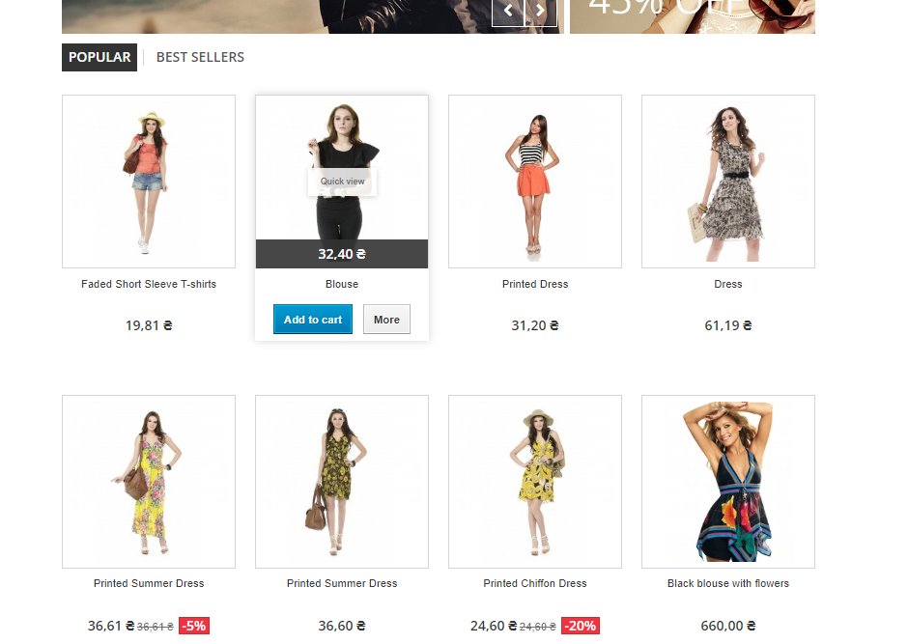
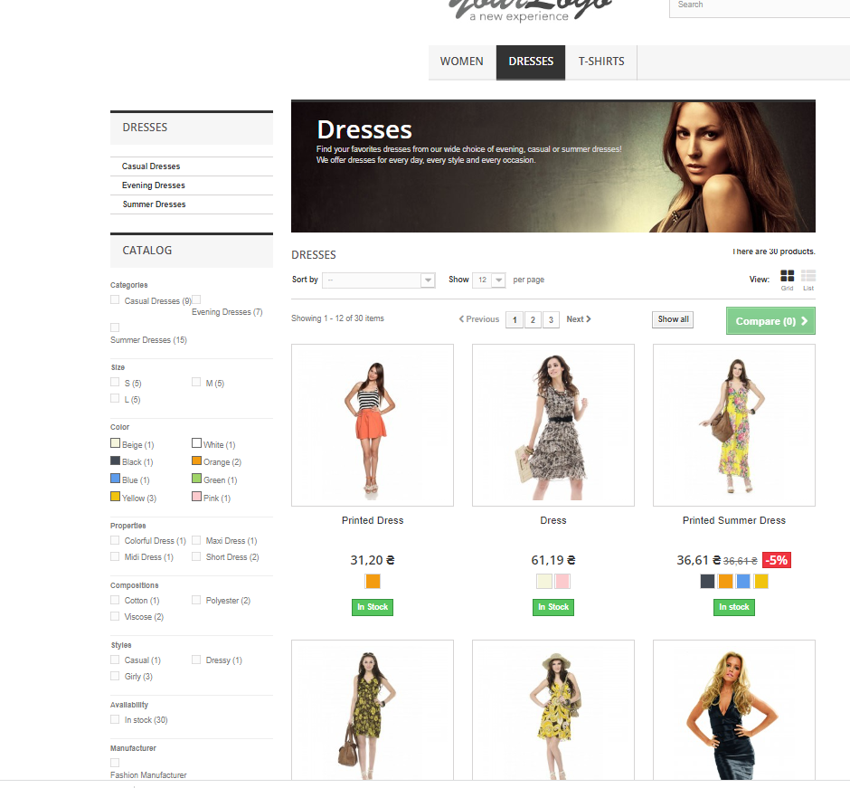
Prestashop tests
This solution is a set of automatic smoke tests executed in the space of an online women's clothing and accessories store http://prestashop.qatestlab.com

Slide 3
Prestashop tests Tech Stack:
Test framework: - Nunit
Logging: - NLog
Reporting - Allure
Browser automation – Selenium
Generator fake data - Bogus

Slide 4
Prestashop tests Used approaches to building a framework / tests
Driver Factory
Browser
Page Object
Browser
Wrappers
Builder for model
Chain of invocation
Bogus

Slide 5
Prestashop tests Difficulties encountered when creating a framework / tests
Locators - Solved by using two/three level XPath locators and taking element by index
Сlicks on hidden items - Solved with Selenium Actions API - move to element method to activate hidden elements
Overlapping pop-up windows with the home page when quickly performing an action on the page - Solved by explicit wait method with ElementDisplayed option

Slide 6
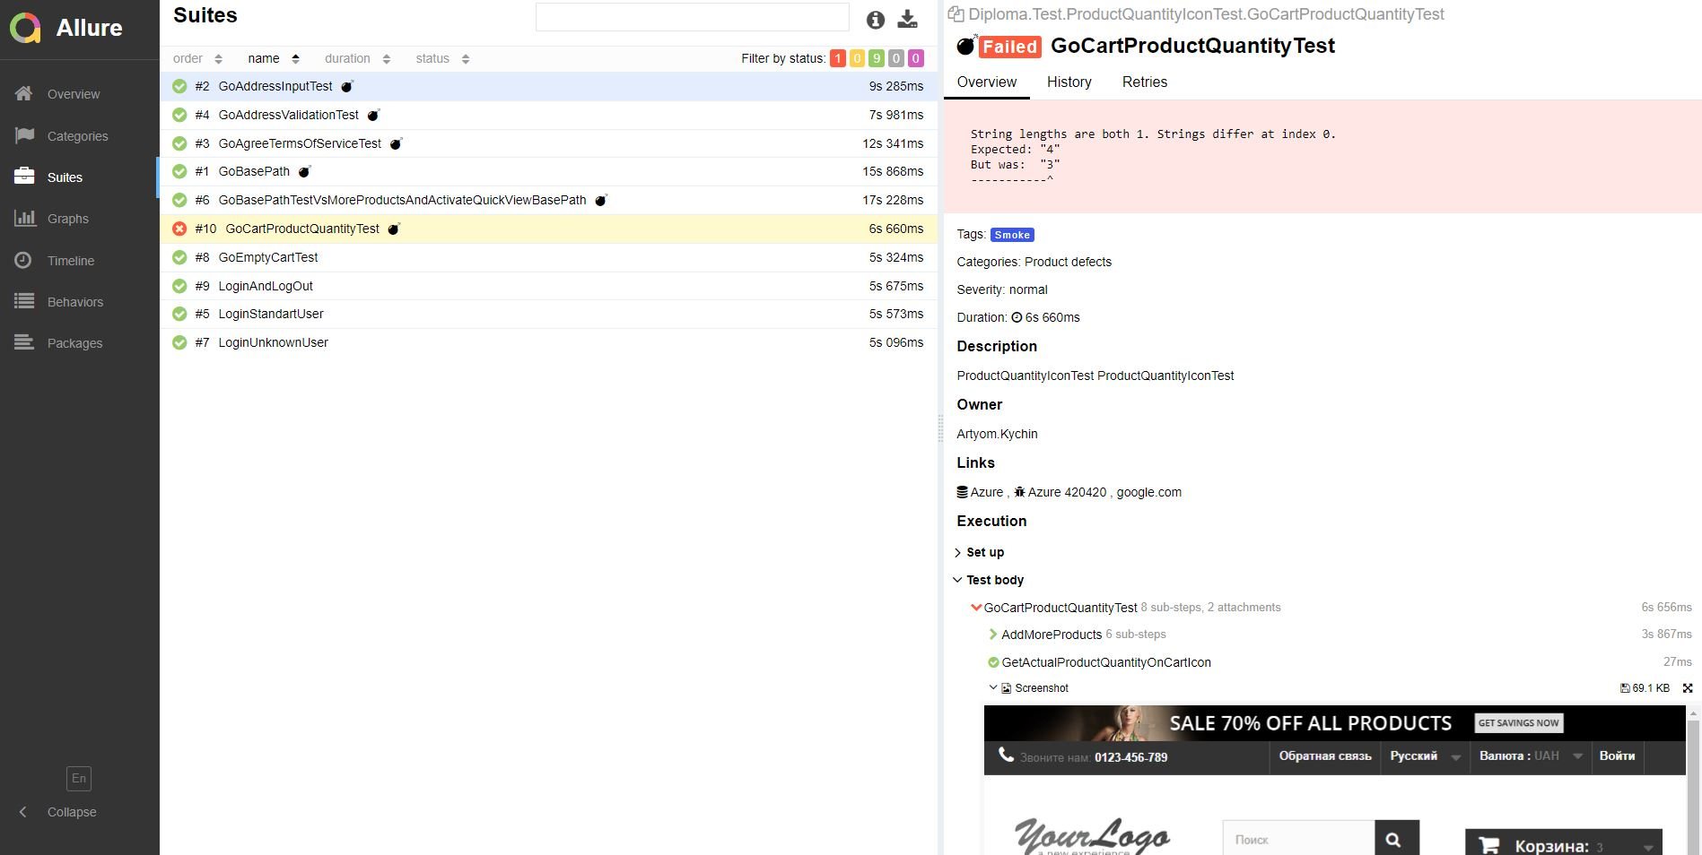
Allure reporting Report exampl

Slide 7
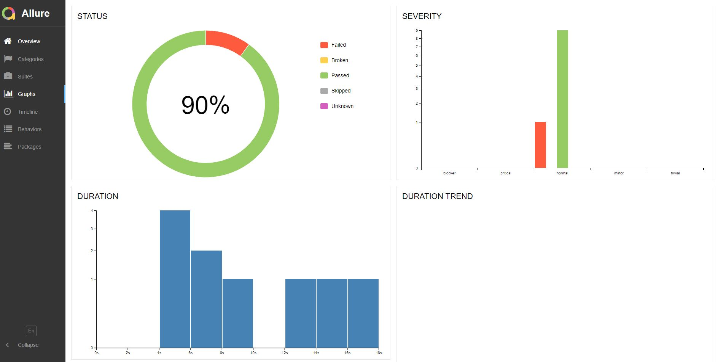
Allure reporting Report exampl

Slide 8
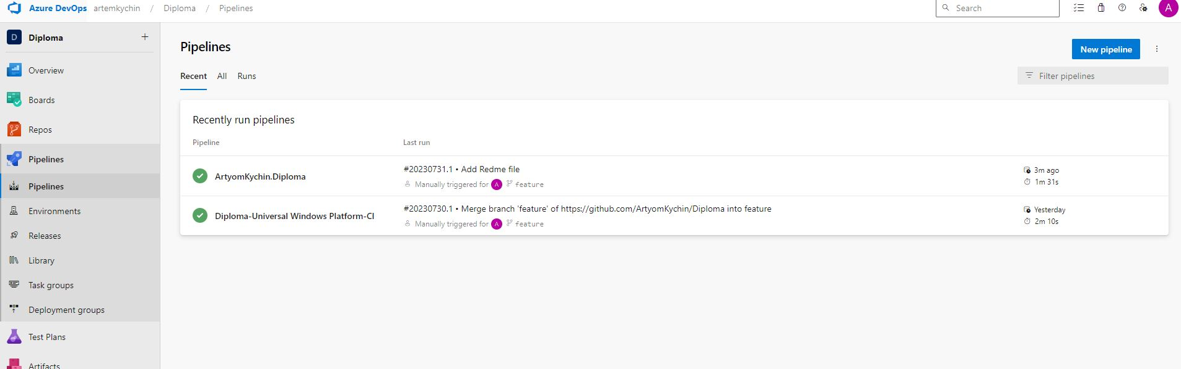
CI CD Azure DevOps
The solution uses integration with the Azure DevOPS CI CD

Slide 9
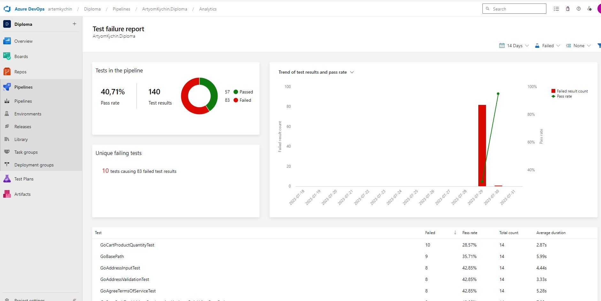
CI CD Azure DevOps

Slide 10
Prestashop tests
Thank you for watching

